Slide 1
Spellcraft & Moonfire
CS541 - Data Mining

Slide 2
Team Spellcraft & Moonfire
Michael Merabi
Omar Alhinnawi
Timothy Lee
John Aquino

Slide 3
Agenda
Introductions
Team
Overview
Hypothesis
Data Pre-Processing
Parsing
Data Warehouse
Results
Broad Analysis
Case Study
Patterns
Conclusion

Slide 4
Overview
We decided to do a project analyzing media bias regarding articles or news stories on the same event but from different publications around the world. This would include comparing publications within the same proximity in comparison to across the world alongside measuring objective data points like the Goldstein scale which determines the intensity of conflict or cooperation which is inherit in different types of international events. This all comes together to test our hypothesis of
“Does the media generally cover negative/violent events more than ones with a positive tone?”

Slide 5

Motivations
These are turbulent times in the world and we know that people like to talk about how everything is generally spiraling down the toilet. Yet is this because the news does report on negative stories more or is it because we have an inherent selection bias to focus on the bad things and forget about the good events that happen?
Also Omar hates fox news *

Slide 6
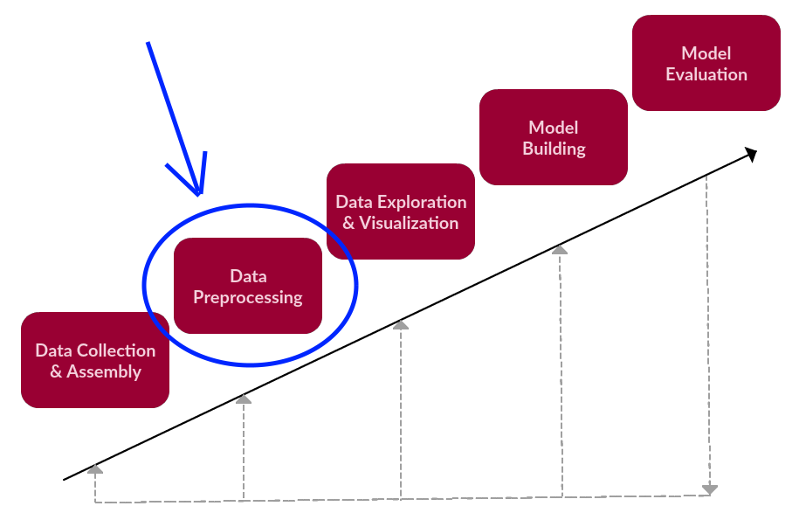
Pre-Processed Data
Data we are looking at:
Scrape Data
Process
Results
Global events from the year of 2019.
The data was archived by GDELT (Global Database of Events, Language and Tone)
Data came in a horrible format that we had to split and extract information from

Slide 7
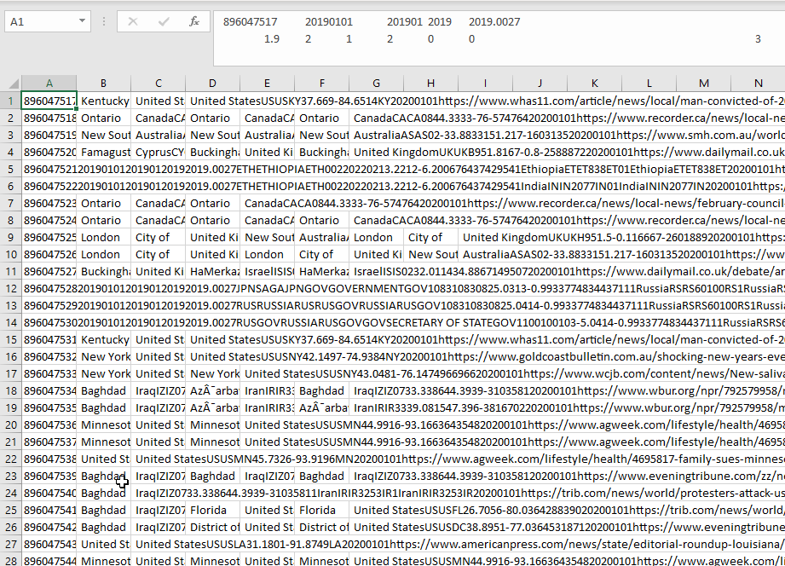
Building the Data Warehouse (Parsing)
As touched upon on the previous slide, we needed to fix our data (this is way worse than it sounds)
The raw data was terrible to work with as there was no easy or discernable way to parse through it.
Most of the data came in packed cells separated with extremely weird spacing.

Slide 8
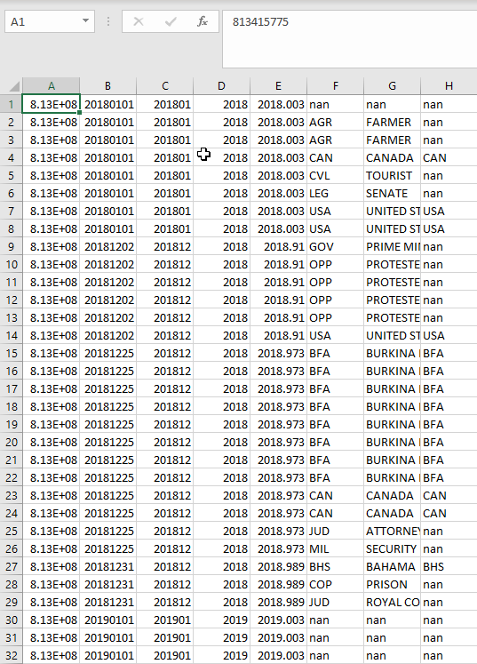
Building the Data Warehouse (Reconstruction)
Using Python as our primary coding tool, we parsed the raw data and distributed it in a fashion where each value has its own cell and column.
This is substantially easier to read in with Data Analysis frameworks such as Pandas or Numpy which require data to be in specific formats.
The new structure allowed us to slice our data in different and more concise ways to better understand our data.

Slide 9
Results: Yes, there is a media bias
# of violent events in 2019: 17,473,193
Avg. reports per event: 2.99
Avg. mentions per event: 15.5
Avg. articles per event: 15.14
# of non-violent events in 2019: 38,719,606
Avg. reports per event: 2.7
Avg. mentions per event: 13.73
Avg. articles per event: 13.43
Note: some outliers were removed for the sake of accuracy

Slide 10
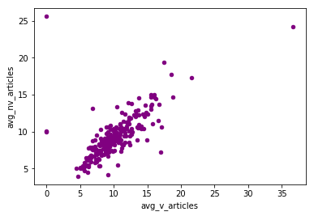
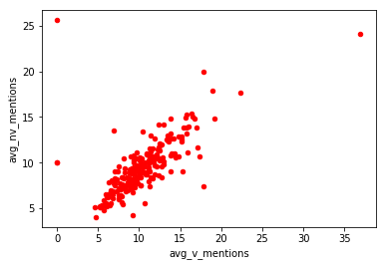
Was this consistent across all nations?
Over 75% of countries saw a lean towards reporting violent events at least 10% more than non-violent events.
There have consistently been more articles and more mentions for violent events for a large majority of nations.

Slide 11

Case Study: North Korea
World renowned Goodboy Kim-Jong Un has been widely criticized of massive brainwashing.
Best Korea is a notoriously peaceful country that focuses on positive things and keeping people well informed.
North Korea was the leading nation in overall media coverage with Non-violent reports having significantly more coverage than violent events (~20-25%)

Slide 12
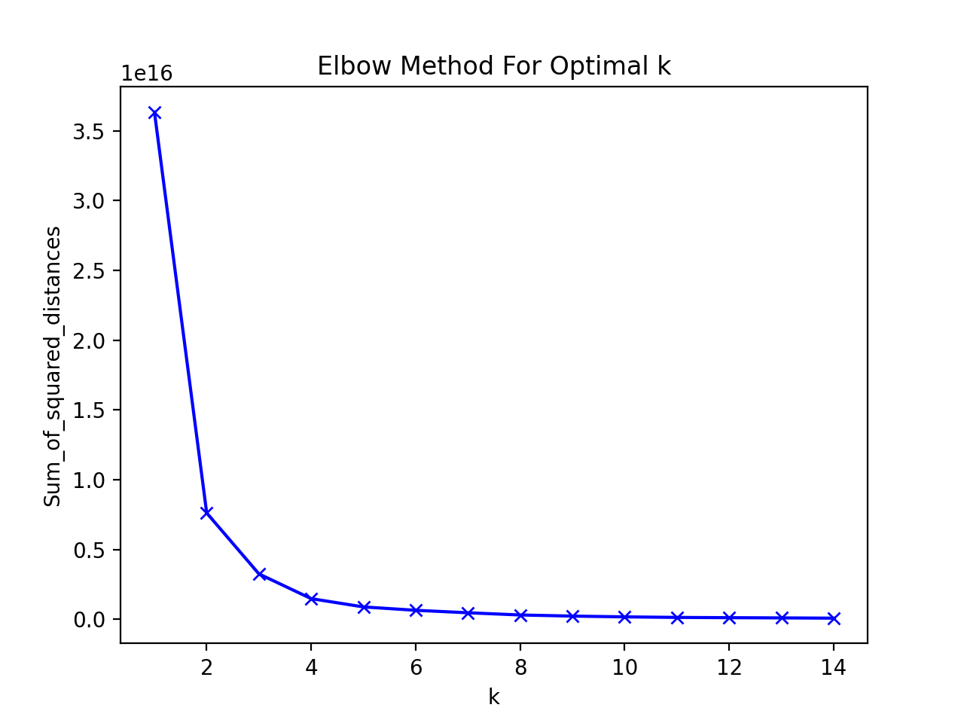
Elbow method is a way of clustering inside of a dataset to find the optimal number of clusters by fitting the model with a range of values for K.
This graph represents how many clusters the events in the previous graph can be fitted to.
Notes:
Found using the python sklearn library
-Elbow method is a popular method to determine the optimum number of clusters in k-means clustering

Slide 13
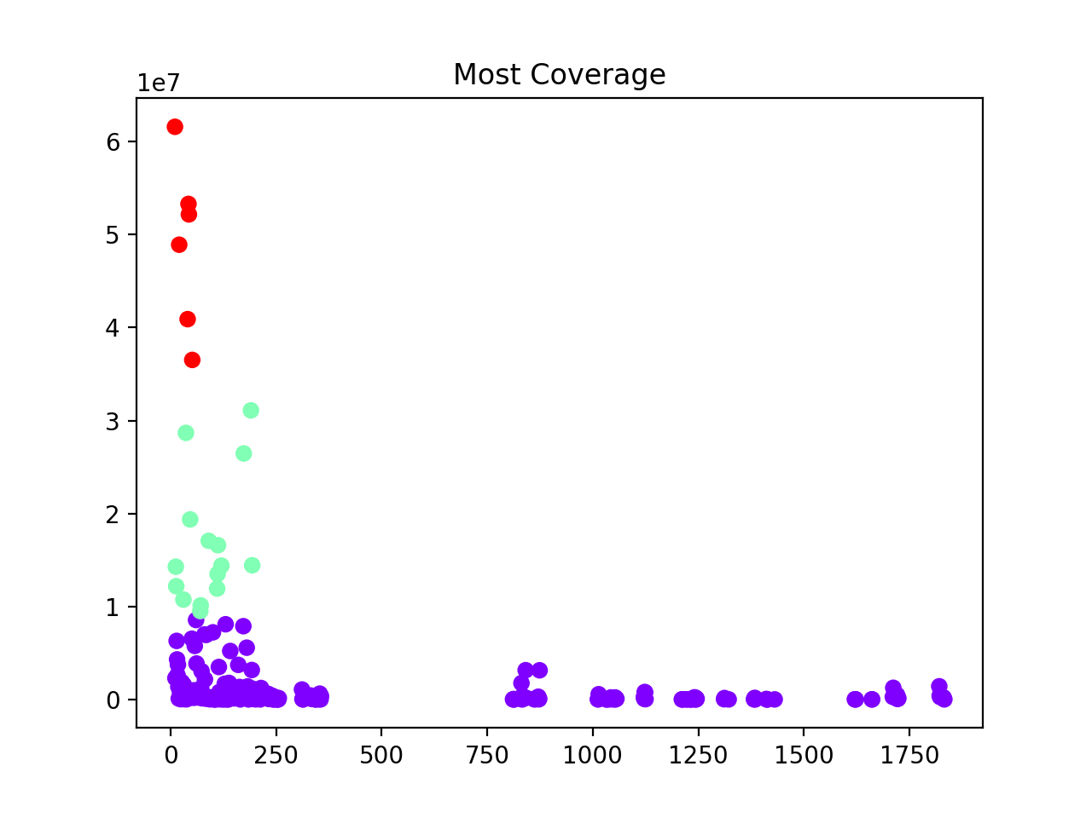
2019’s theme: Lot’s of talk with the occasional military reform
A Node analysis found that Visitations, praises, and use of military to push agendas were the most broadly covered events of 2019.
The events that follow up are boring things like democracy, countries selfishly providing aid to other countries and talks of cooperation.

Slide 14
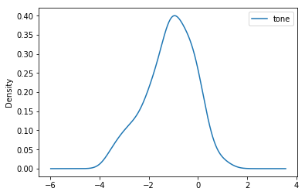
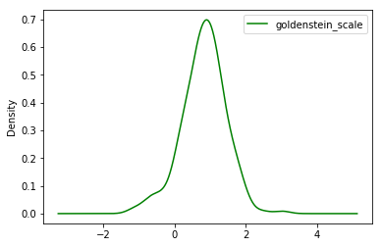
Tone & Impact Analysis
Tonal analysis of 2019 saw a majority of country have a negative shift in tone for all media regardless of how many events were recorded for the country that year.
Countries generally were positively impacted in 2019, this can be attributed to the ratio between violent & non-violent events.

Slide 15
Pattens we’ve seen
There exists a noticeable negative correlation between higher tone and general media observations.
If the U.S. was involved in an event with another foreign country, it was usually negative.
The U.S. has an anomalously high amount of controversial events happening compared to other countries, almost six times as high as the next (although it could be argued that GDELT itself is biased in how it collects its data)

Slide 16
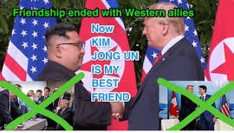
Conclusion: What can you take away from this?
There is a very real bias in the media.
Humans are naturally inclined to focus on the negative.
North Korea is an idyllic country to follow.
Do not agree to trade deals with U.S.
35
25
22
15

Slide 17
End
Any Questions?

